Slide 1


WhatsApp outside. A governed workflow inside.
Vinayak Prasad · Hamid Ansari · Dhananjay · Fizzy
platform · Demo & Workshop · 2026
Notes:
Welcome. One line: customers stay on WhatsApp, the institution gets a governed workflow. Introduce the four of us briefly.

Slide 2
THE PROBLEM
Your customers live on WhatsApp. Your compliance doesn't.
Chaos
Drop-offs
Risk
KYC documents arrive in personal chats — unencrypted, untracked, unauditable.
Every extra step loses customers; RMs burn hours chasing PDFs manually.
RBI and GDPR expectations — versus screenshots forwarded across phones.
Regulated onboarding is stuck between the channel customers want and the control the regulator demands.
Notes:
Ground the pain: KYC over personal chats is chaos, drop-offs, and regulatory risk. Every buyer in the room has lived this.

Slide 3
THE INSIGHT
Don't move the customer.
Move the workflow.
Customers stay on the WhatsApp they already use. The institution works in Veriphy — every document encrypted, every step governed, every action on an audit trail.
Notes:
Pause on this. The whole product in two sentences: the customer never moves; the workflow does.

Slide 4
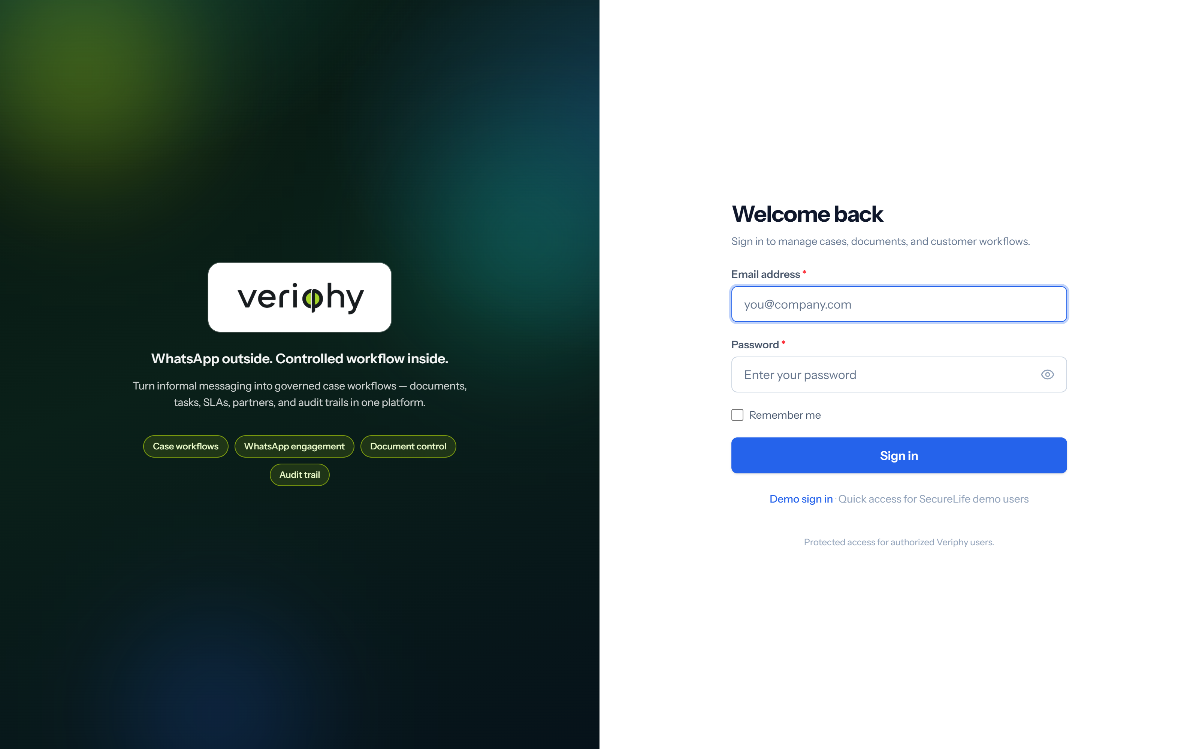

INTRODUCING VERIPHY
The secure workflow engine for document collection, verification & processing.
API-first. Compliance-ready. Deployed for regulated industries.
Available by invitation.
The p in Veriphy is φ — the golden ratio.
Notes:
Position it: a workflow engine, not a chat tool. API-first, compliance-ready, by invitation. Mention the phi in the name.

Slide 5
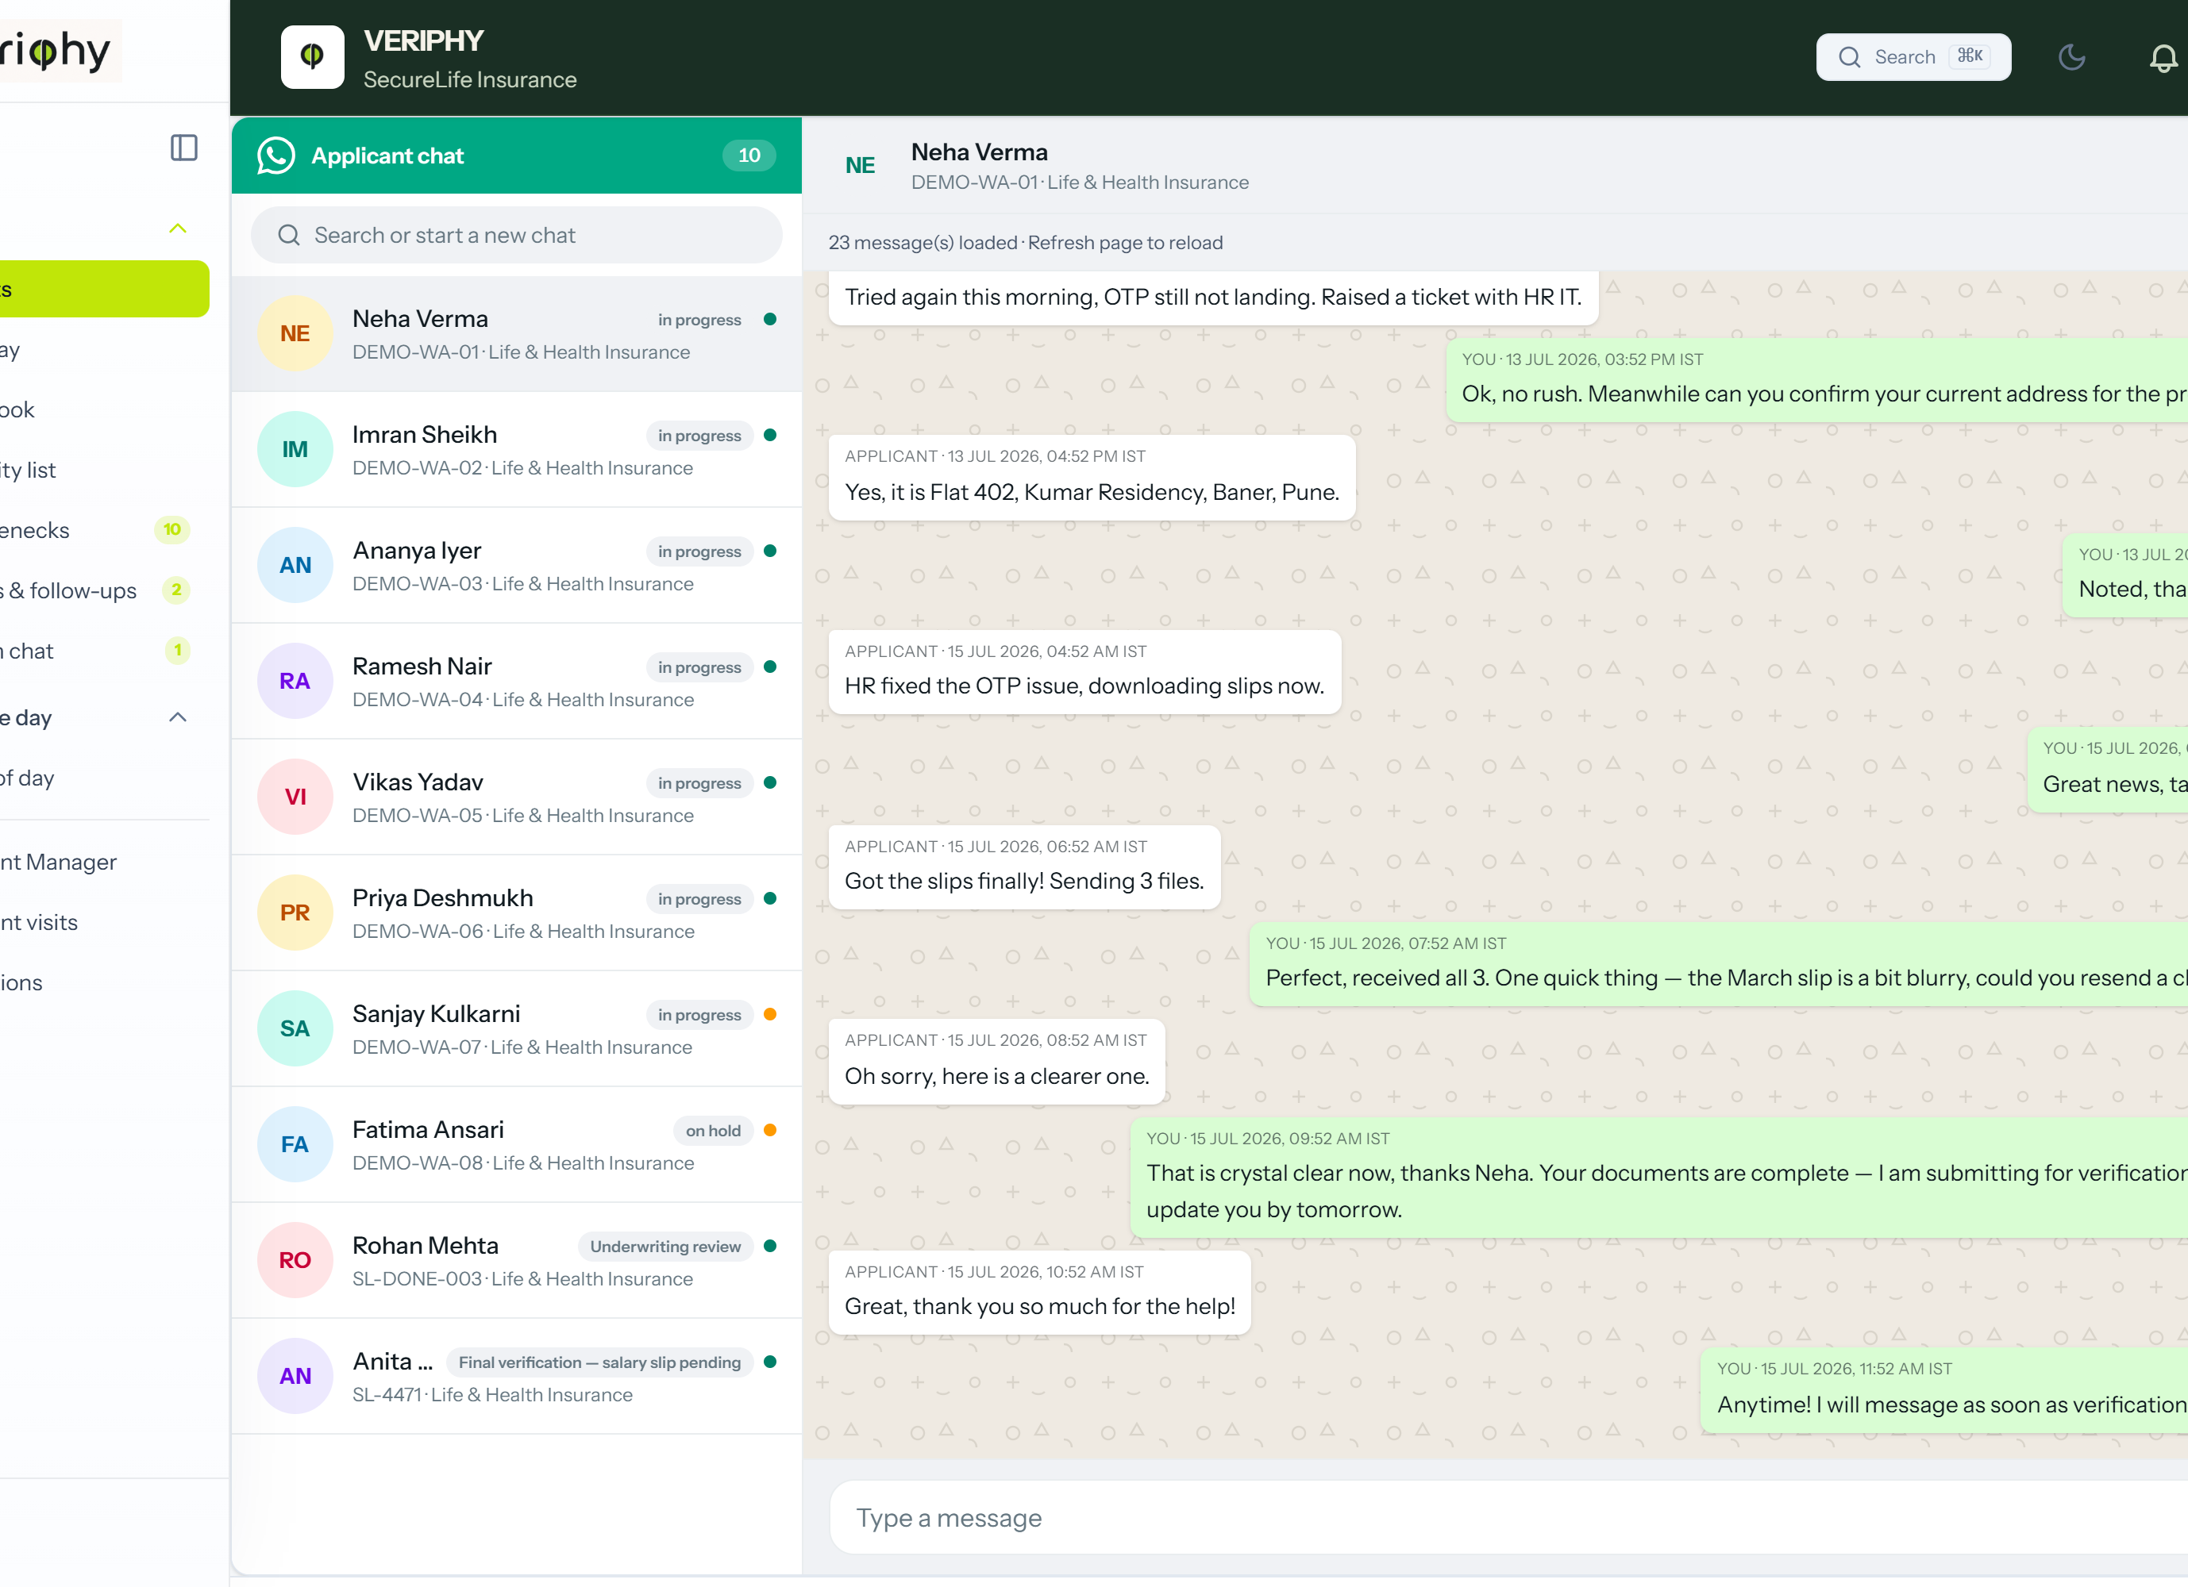
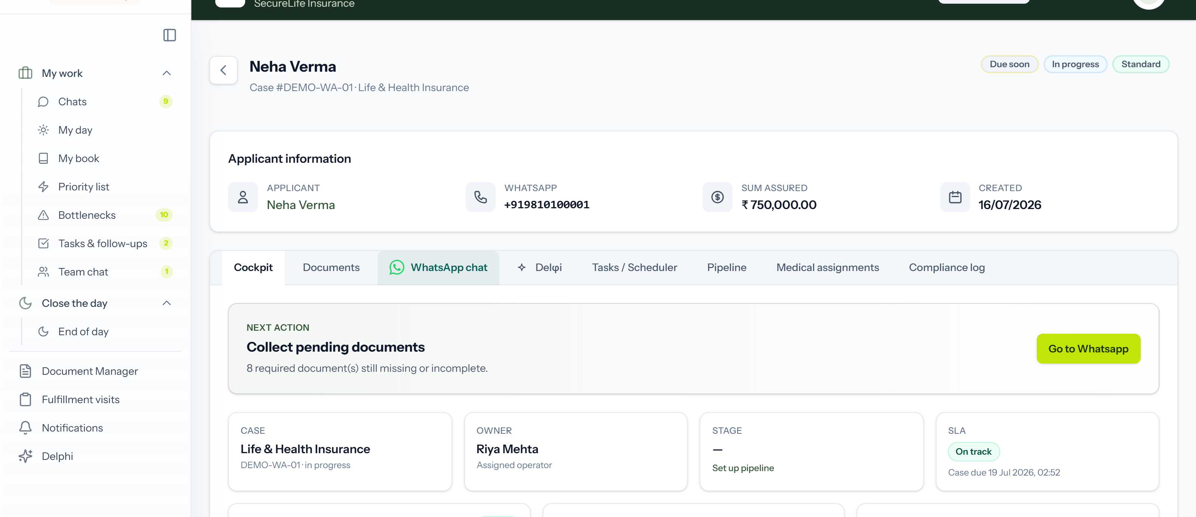
HOW IT WORKS
From a WhatsApp "hi" to a closed, compliant case.
1
2
3
4
5
Engage
Capture
Verify
Track
Close
Campaigns, reminders & document requests over WhatsApp.
Every message and document lands in a governed case.
Preview, approve, reject; blurry docs auto-flagged.
Colour-coded journeys, SLAs and timelines.
Sanctioned, issued, audited — end to end.
Notes:
Walk the five steps left to right, then point at the two screens: WhatsApp on the outside, the governed case on the inside.

Slide 6

SECURE BY DESIGN
Built for the regulator in the room.
Encryption
Role-based access
At rest and in transit, for every customer document.
Staff see only what they should — down to blurred documents for RMs.
Tamper-evident audit trails
Compliance-ready
A complete history on every case, message and action.
Architected for RBI expectations and GDPR/CCPA privacy principles.
Notes:
The compliance slide — keep it plain. Encryption, RBAC down to blurred documents, tamper-evident trails, RBI and GDPR alignment.

Slide 7
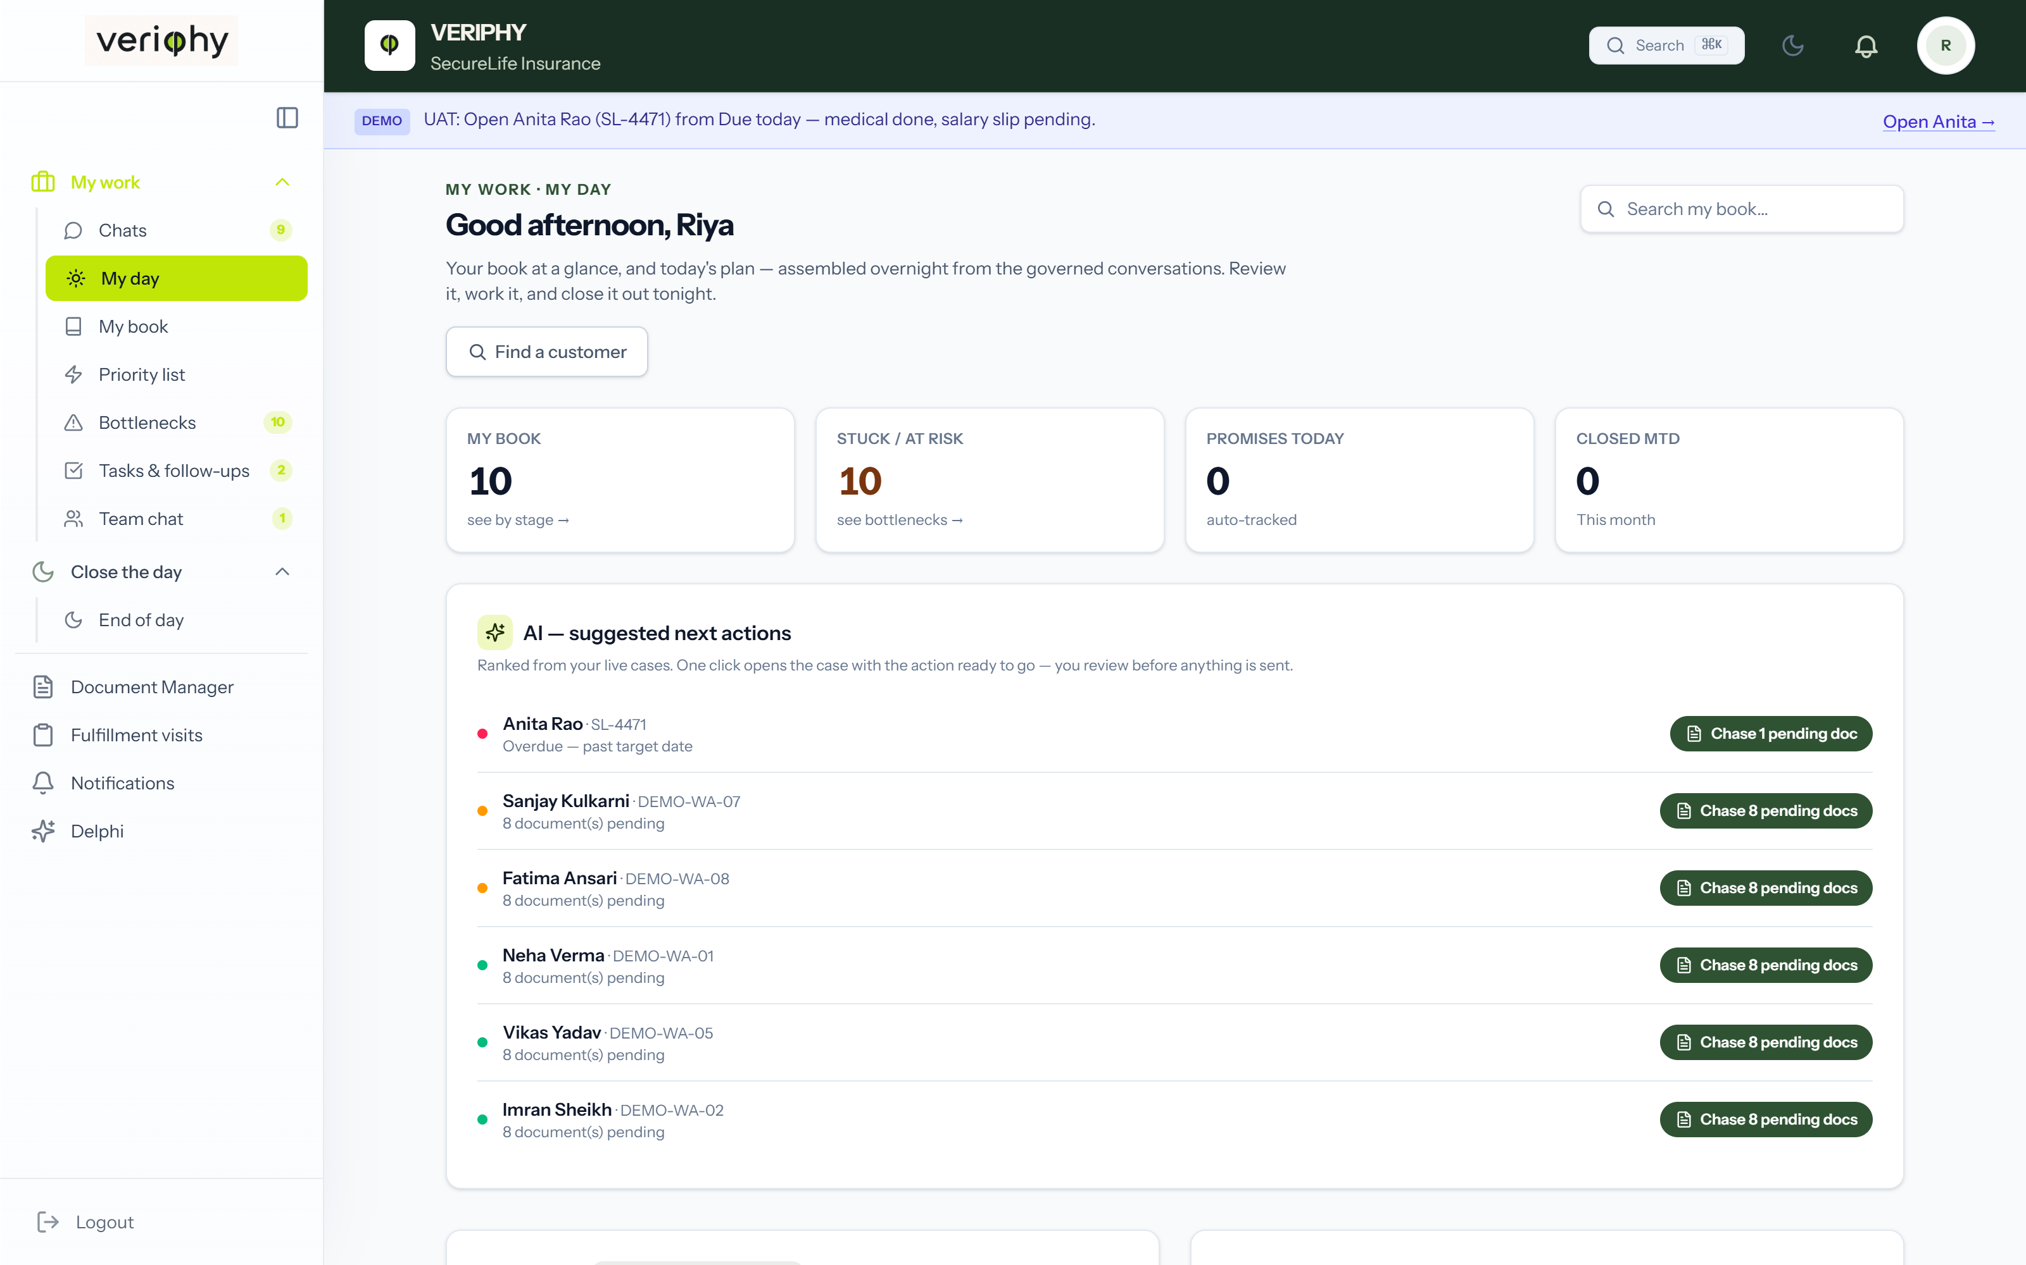
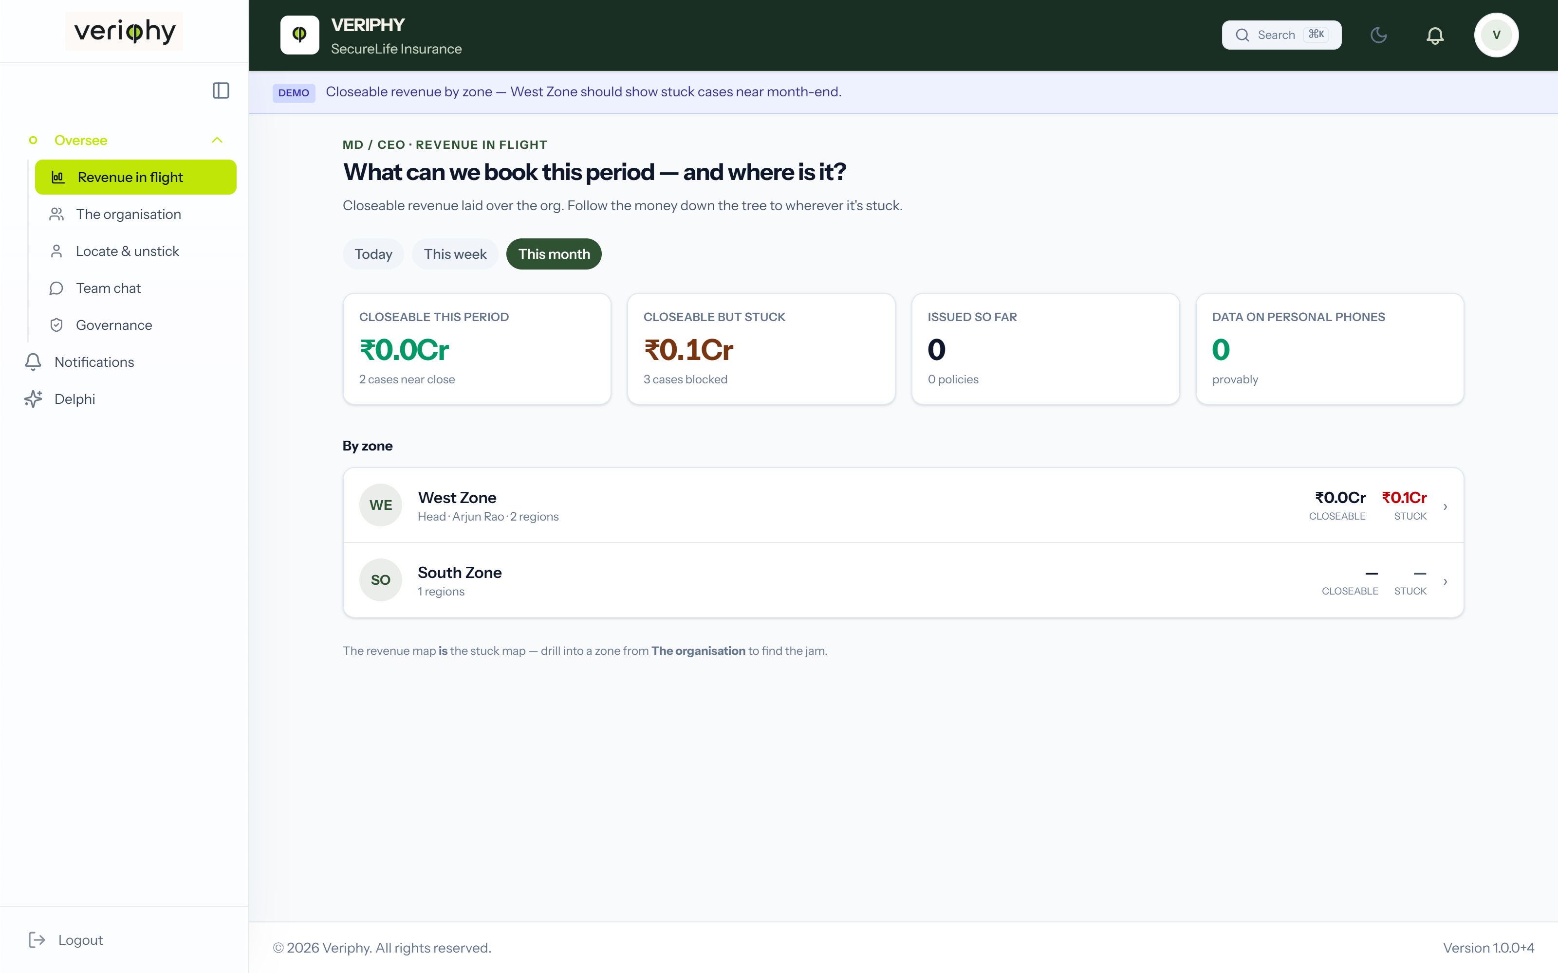
NOTHING SLIPS
Real-time visibility from rep to boardroom.
The rep's morning — My Day
The leadership view — Executive dashboard
Colour-coded journeys
SLA & bottleneck tracking
One-tap escalations
Notes:
Two altitudes of the same truth: the rep's ranked morning on the left, the MD's executive view on the right.

Slide 8
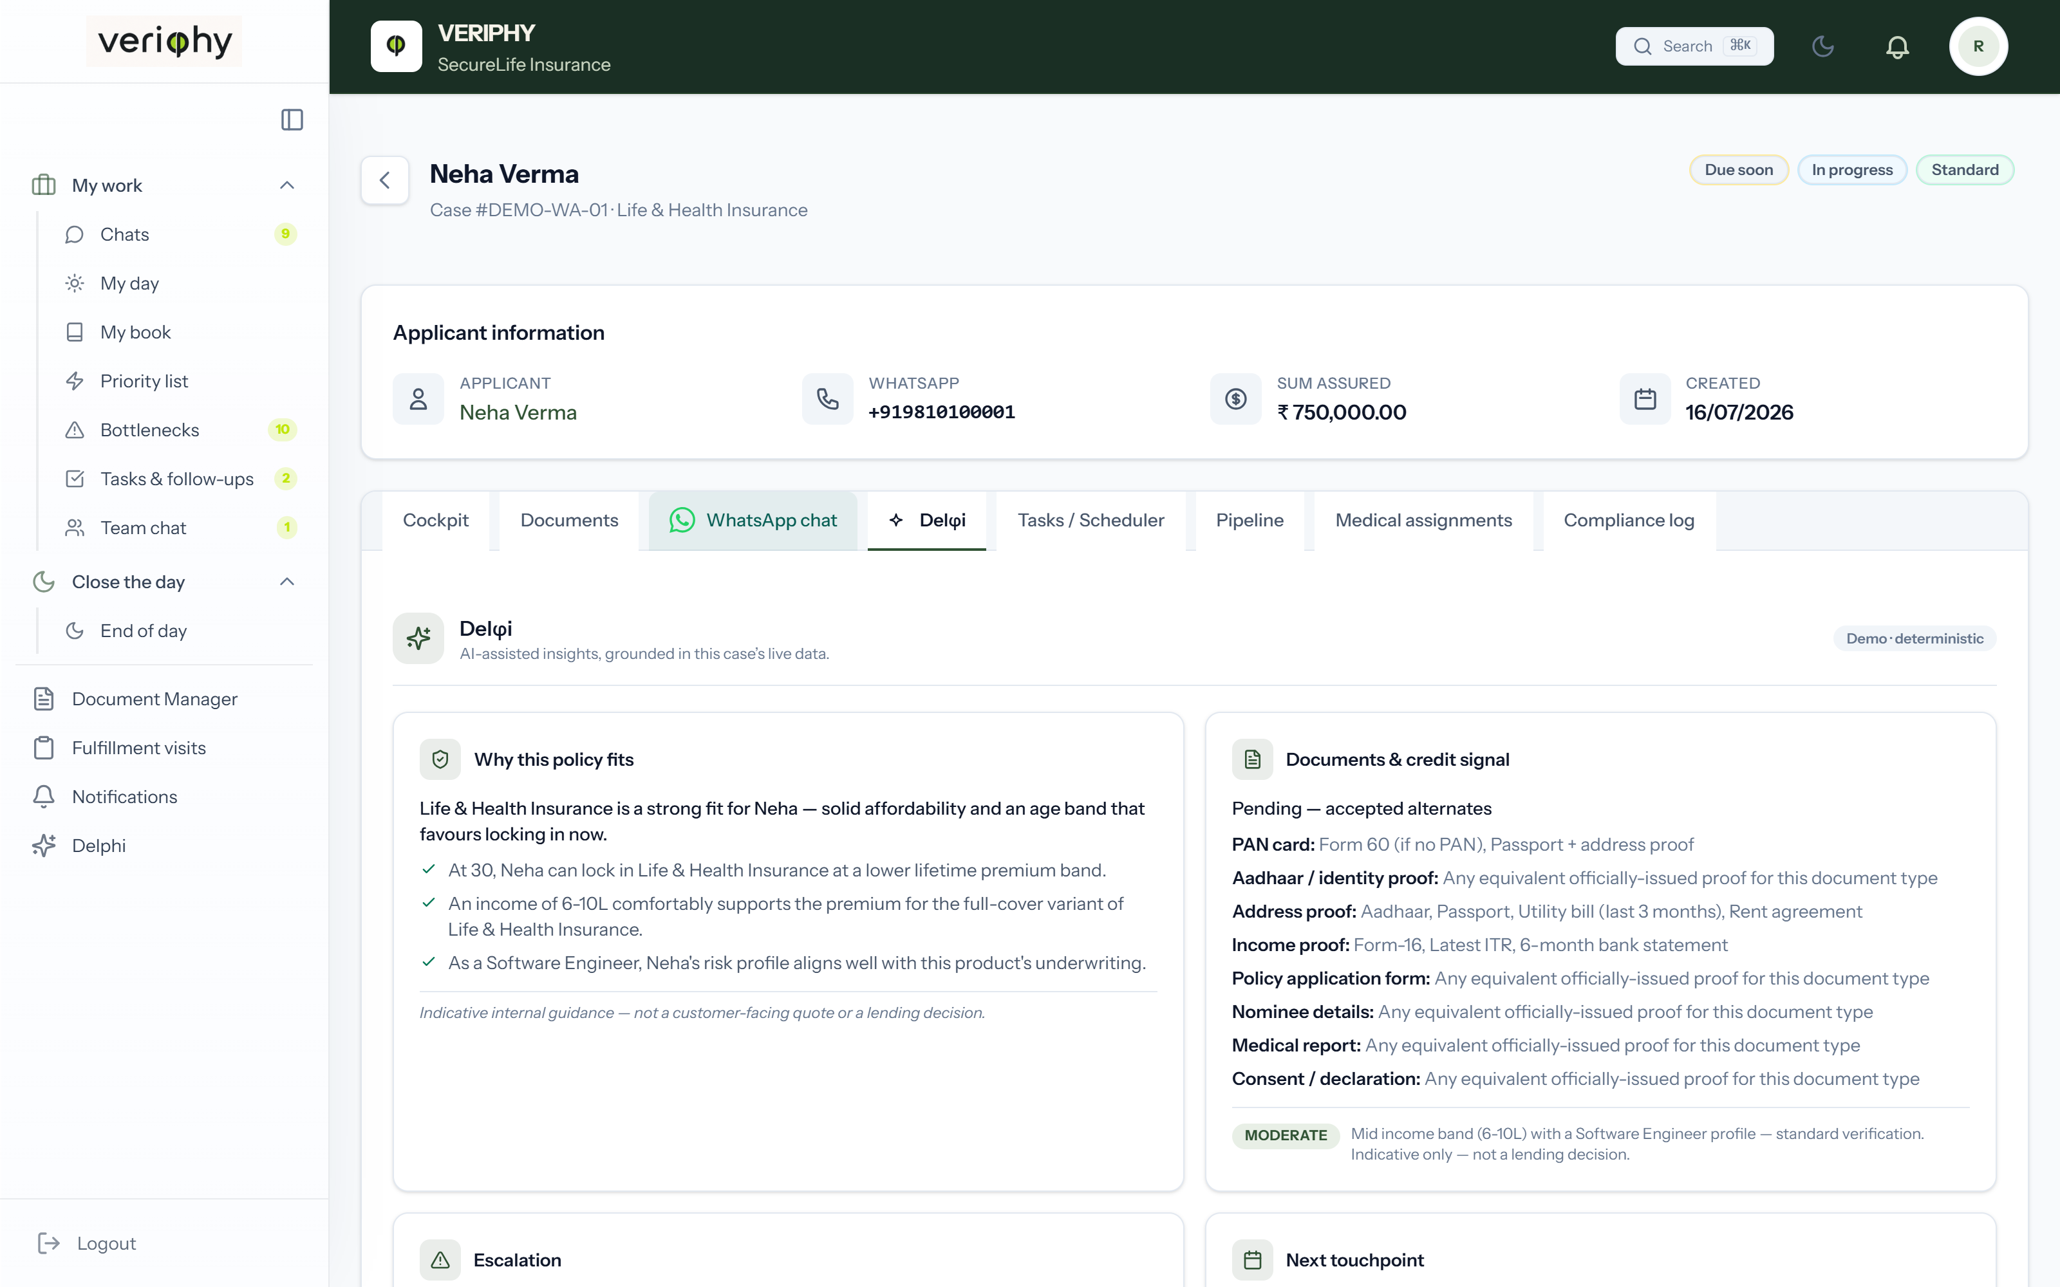
THE COPILOT
Delφ i — an oracle on every case.
Veriphy's AI copilot. Grounded only in the case's own data. It never invents.
Why this policy fits
Documents & credit signal
Escalation advisor
Next touchpoint
Grounded chat
The φ in Veriphy is the golden ratio — the proportion of spiral galaxies. Delphi carries the φ, and the Oracle of Delphi carried the answers.
RBAC-scoped · read-only · every recommendation is a human's decision to act on
Notes:
The star slide. Delphi is grounded only in the case's own data — it never invents. Tell the name story: phi, the golden ratio; Delphi, the oracle.

Slide 9
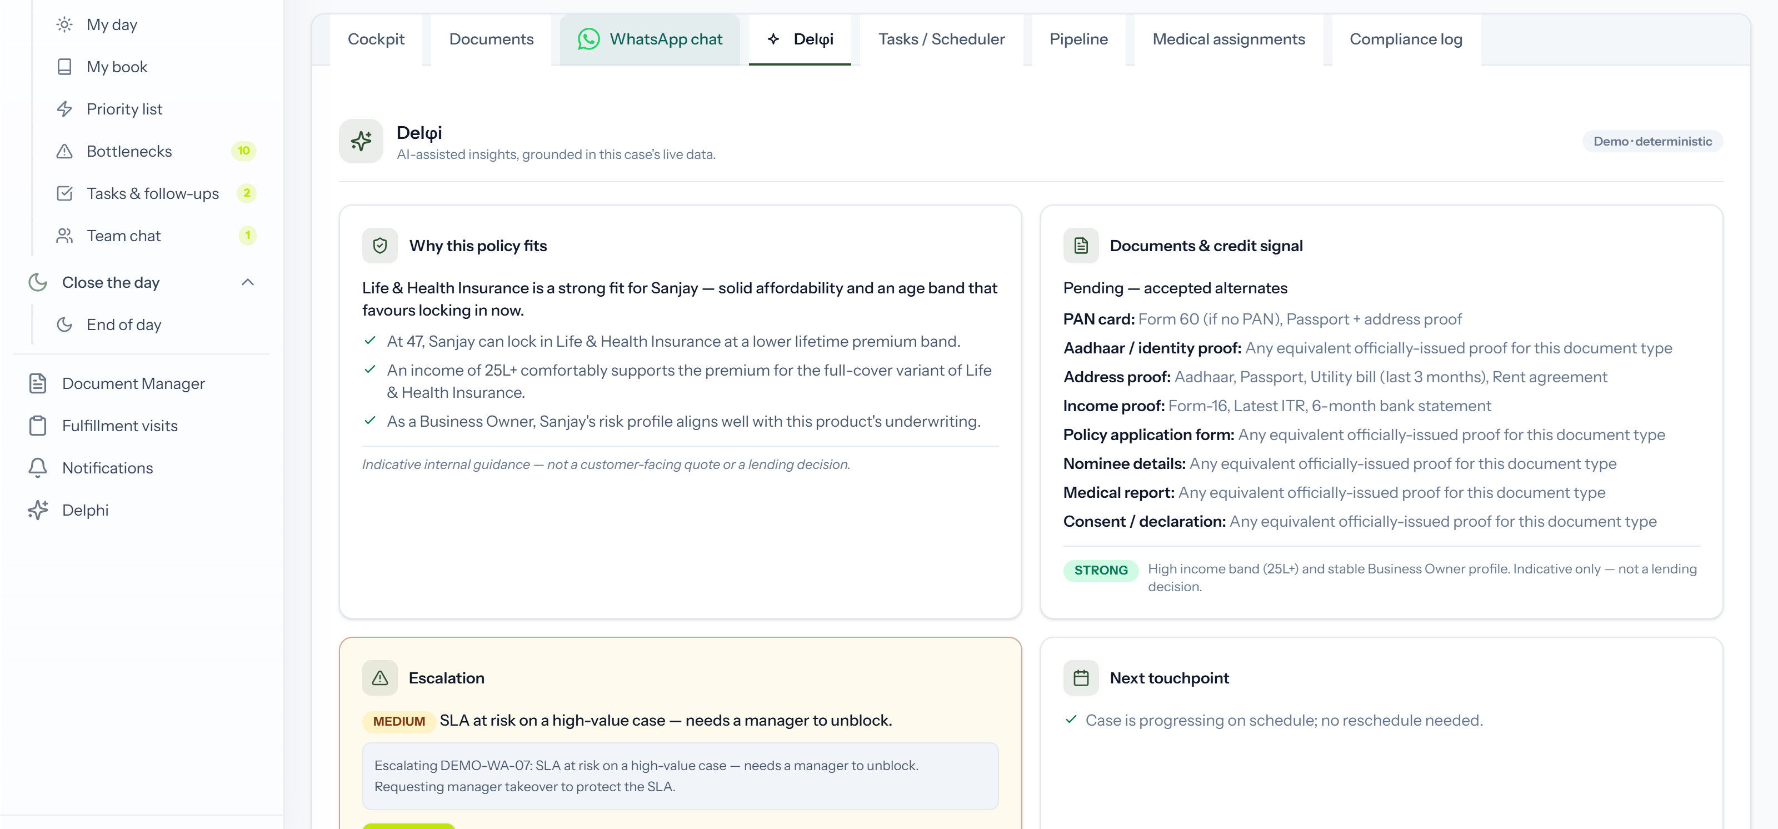
THE COPILOT AT WORK
It watches the risk you don't have time to.
Recommend + one click. The AI advises; your team acts.
Notes:
One concrete moment: a high-value case drifting toward SLA breach. Delphi drafts the escalation; a human sends it.

Slide 10
USE CASE — POST-DISBURSEMENT DOCUMENTATION FOR NBFCS
PDD without the chase.
TODAY
WITH VERIPHY
Delayed submissions
Automated campaigns from your LOS/CRM
Manual RM follow-ups
Hyper-personalised nudges that adapt to each borrower
Informal channels
End-to-end tracking, rule-based RM escalation
RBI compliance risk
Full auditability
IMPACT
Faster document turnaround
Reduced RM workload
Fewer drop-offs
Audit-ready compliance
Better borrower experience
Notes:
The wedge use case for NBFCs: post-disbursement documentation. Contrast the manual chase with automated, audited collection.

Slide 11
INDUSTRY-AGNOSTIC
One engine. Every regulated onboarding.
Banking & NBFC
Insurance
Healthcare
Loans, KYC
Policy issuance, claims
Patient onboarding
Real estate
Education
Marketplaces & gig
Tenant & buyer verification
Admissions
Seller & vendor KYC
API Factory
RESTful APIs & webhooks into your CRM, LOS, core banking.
Notes:
Same engine wherever a regulated business collects documents from people. API Factory plugs it into whatever stack they run.

Slide 12
WHY FROG8
Built by operators. Proven in production.
NAMMA METRO · BMRCL
DAILY KIOSK TRANSACTIONS
TVM 4000 · FULL-KYC CARDS
EXPANDED DEPLOYMENT
Official TSP
10K+
45 sec
Aug 2025
Technology Service Provider to Bengaluru's metro
99.9% uptime since April 2024
A first in India outside bank branches
Inaugurated by the Prime Minister
"Innovation through deployment. We don't design in a lab — we build for the real world."
Notes:
Credibility: BMRCL TSP, 10K+ daily kiosk transactions at 99.9% uptime, full-KYC cards in 45 seconds, PM-inaugurated expansion. We build for the real world.

Slide 13
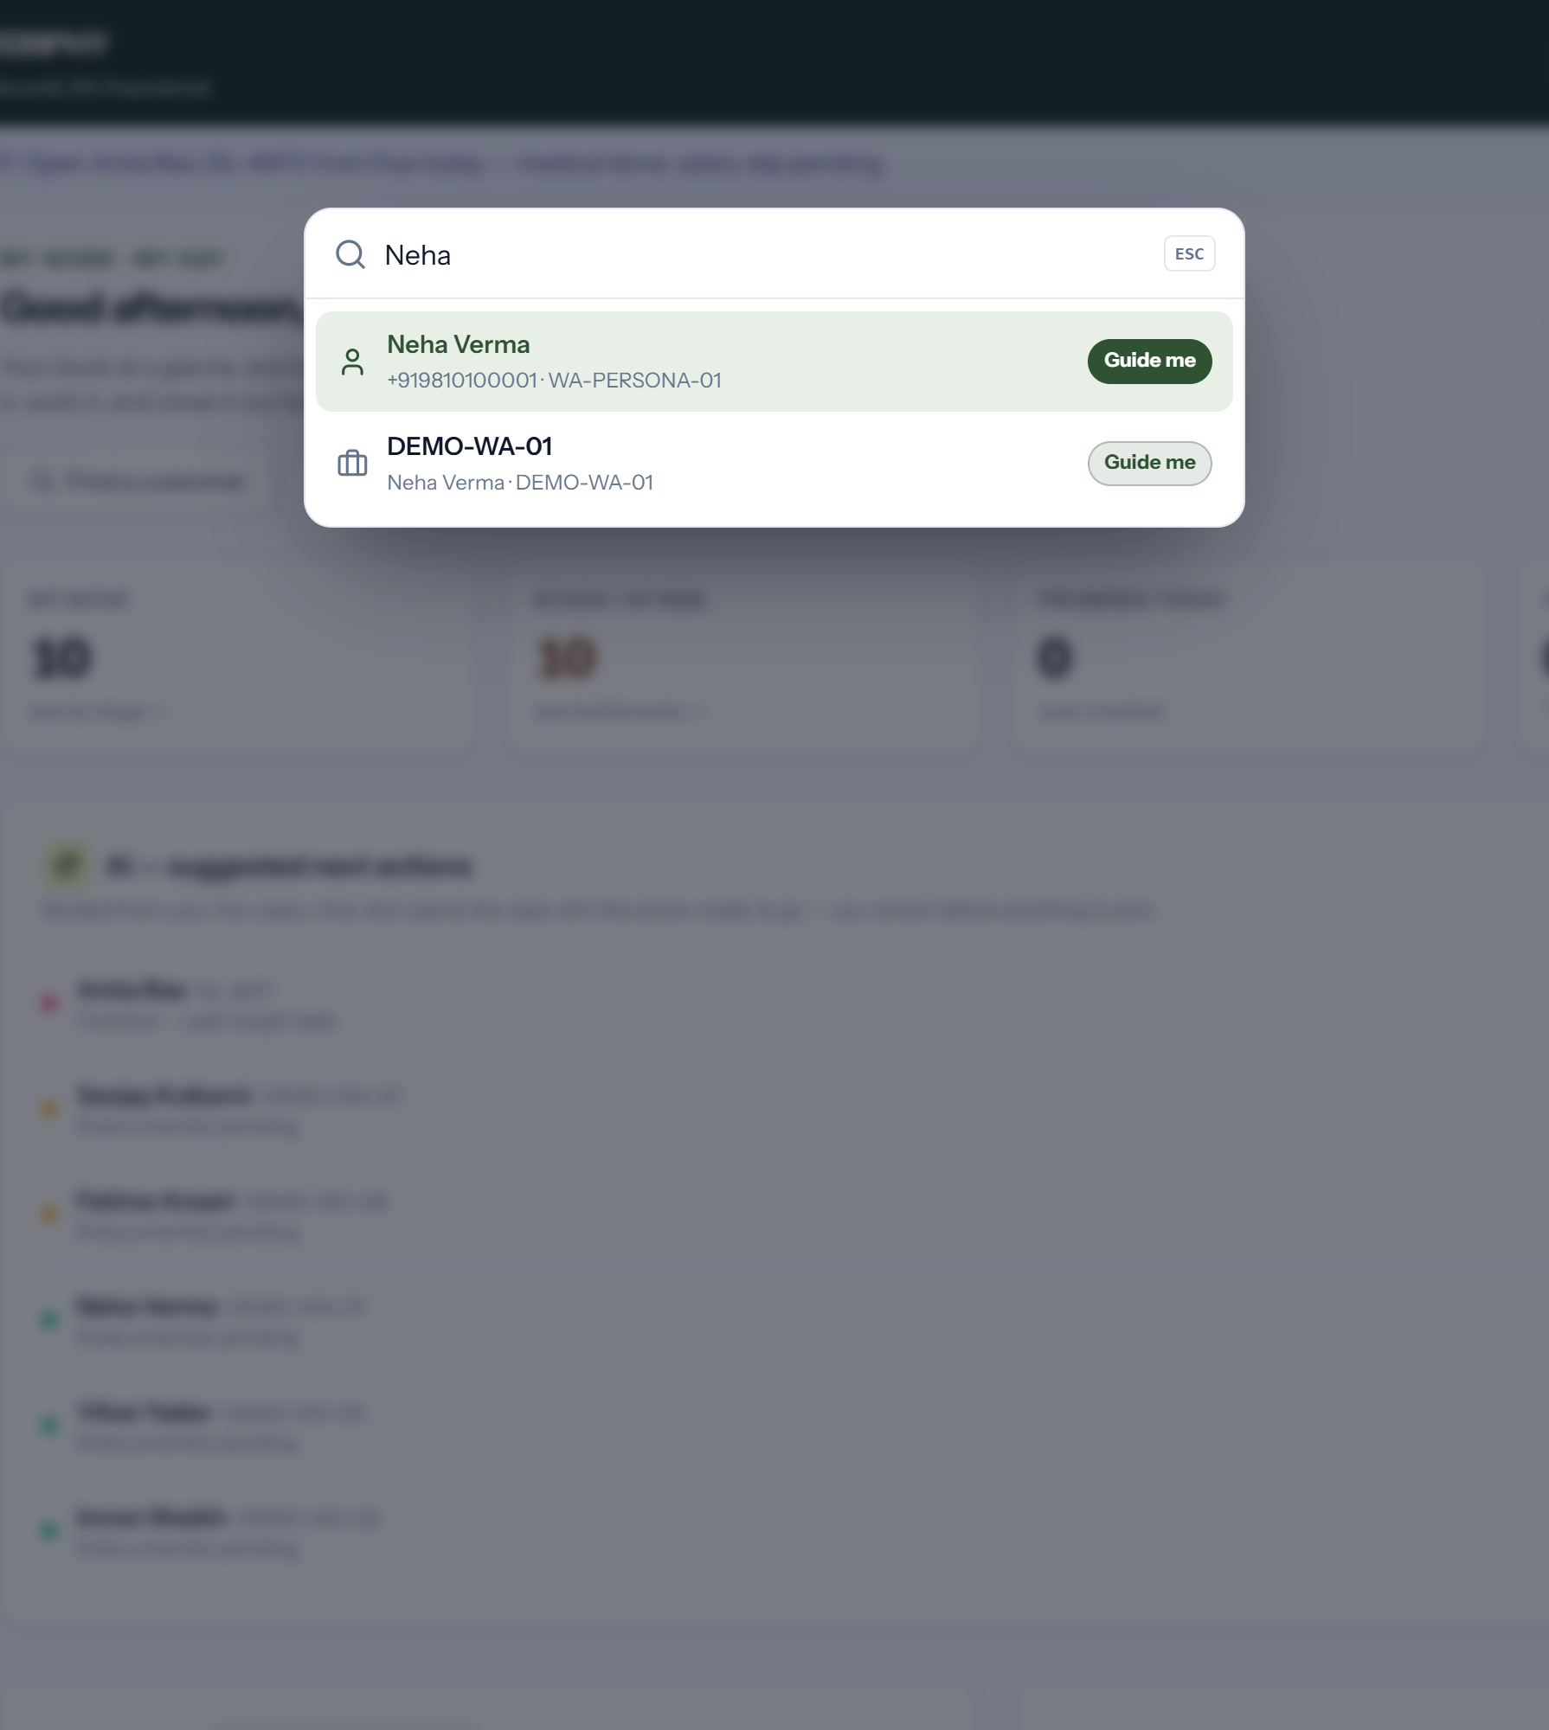
WHAT YOU'LL SEE TODAY
Ten minutes in the product.
1
The pitch, in-product — "See Veriphy in 90 seconds"
Fizzy
2
A rep's morning — My Day, AI-ranked next actions
Fizzy
3
A live case — WhatsApp thread → governed cockpit
DG
4
Delφi — policy fit, credit signal, escalation
DG
5
Search & guided navigation — find anything, be walked to it
Fizzy
6
The leadership view — exec dashboard & bottlenecks
Vinayak
7
Compliance close — audit-trail walk-through
Hamid
Notes:
Set expectations for the demo: seven beats, ten minutes, four presenters. Then switch to the product.

Slide 14
NEXT STEPS
Veriphy is available by invitation.
1
2
3
Workshop
Pilot
Deploy
Map your PDD and onboarding flows.
Your data, your rules — 4–6 weeks.
API-first integration with your stack.
φ
veriphy.io · frog8.co.in
WhatsApp outside. A governed workflow inside.
Notes:
Close: workshop, pilot, deploy. Leave the invitation open and the contact on screen.

